Slide 1
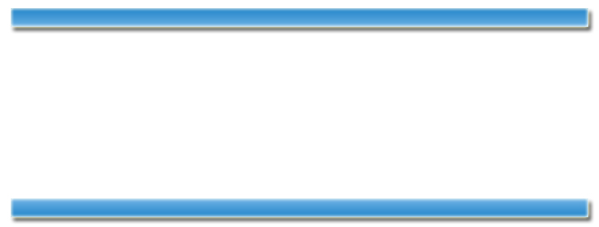
Welcome to CSCI 330! ☺
The UNIX system

Slide 2
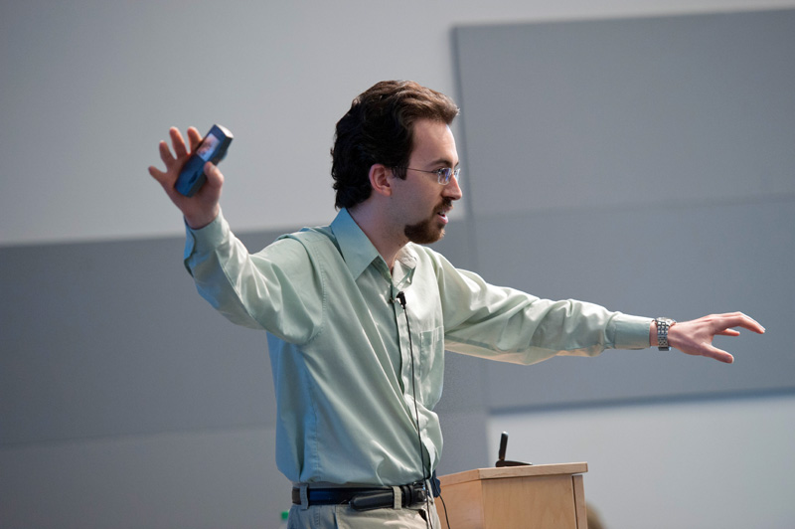



Introducing people
Dr Philippe J. Giabbanelli
that‘s me ;-)
giabba@cs.niu.edu
Office: PM461
T/Th 12:15-2:00,
3:15-4:00
2
Welcome in

Slide 3
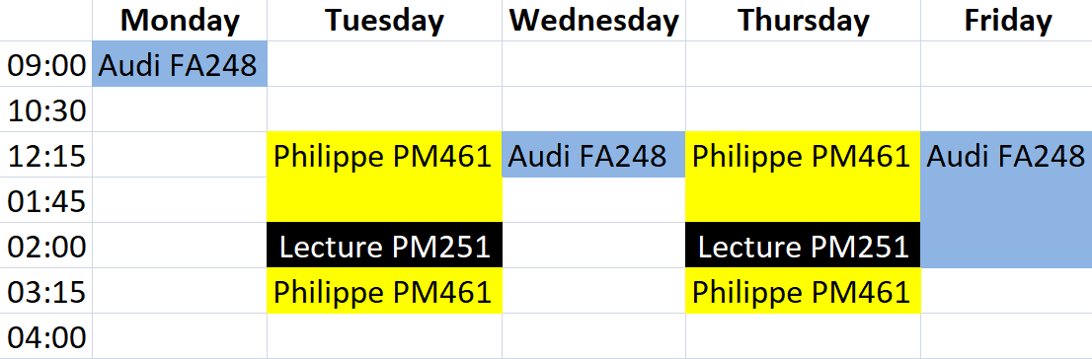
Introducing people
Instructor
(administrative questions)
TA
(non-administrative questions)
Dr Philippe J. Giabbanelli
Mr Audi Bayron
giabba@cs.niu.edu
z1789895@students.niu.edu
3
Welcome in

Slide 4

Questions for today
How does this course work?
What’s this course all about?
How do I prepare for the course?
4
Welcome in

Slide 5

Course timetable
For this week ONLY, we will be in CSL on Thursday. That’s the lab in the basement.
We will show you how to get ready for this course. So you better be there!
You will need an 8Gb USB memory stick formatted in NTFS
OR...
your own laptop
5
Welcome in

Slide 6

Grading
24% assignments
4 assignments @ 6% each
28% quizzes
7 quizzes @ 4% each
46% exams
100%
Midterm @ 20%
Final @ 26%
2% setting up your machine
This Thursday in the lab
6
Welcome in

Slide 7


Grading
Assignments are all submitted through the course website. The submission server closes at the deadline.
The TA will try to give you a fast feedback, so everyone’s work has to be in at the same time.
You can submit as many times as you want, up to the deadline. So send backups!
7
Welcome in

Slide 8

Grading
You will be told about one class ahead that a quiz is coming.
The content for each quiz is everything that you learned since the last quiz.
8
Welcome in

Slide 9

Grading
For the date of the final exam, check:
http://www.niu.edu/regrec/dates/schedules/standardexams.shtml
The midterm exam is expected when we are done with Shell programming, roughly halfway through the course.
9
Welcome in

Slide 10
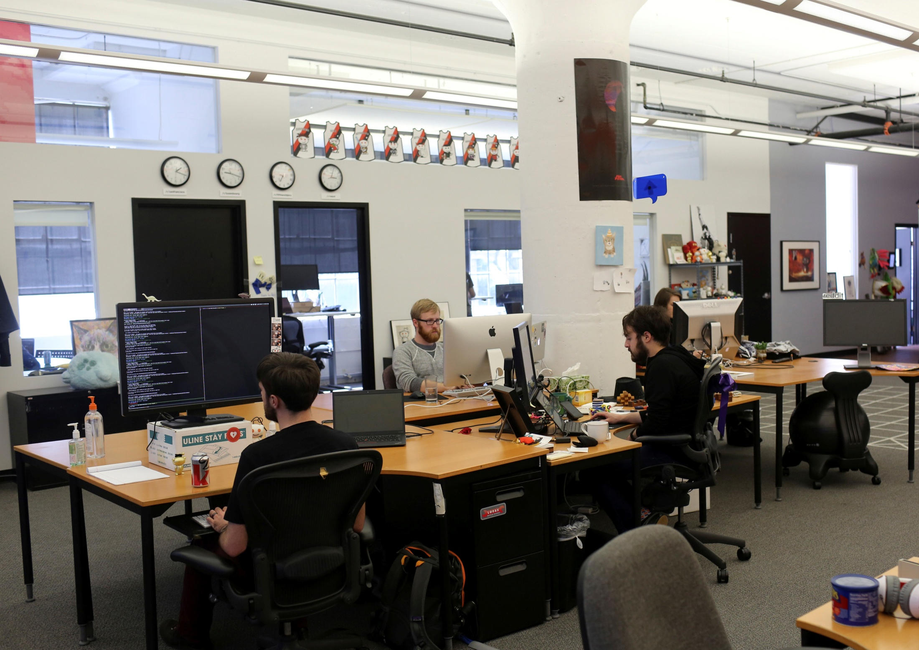
Cody has to write code for his work but he doesn’t know how.
This is Cody.
Like last week, he’ll asks his colleagues if anyone can help him do his job. And next week he’ll ask again...
Cody doesn’t want to ask his colleagues. So he finds someone else to do his work online, and he pays.
→ Why should his colleagues be paid to do Cody’s work?
Let’s just fire Cody and hire someone competent.
→ Is it sustainable for Cody to fake he knows the job by paying someone else? Can this give away company secrets?
10
Welcome in

Slide 11
Grading
When given an individual assignment, you’re graded on design originality. Your job one day is to design solutions.
In our line of work, you cannot ask others to help you with your job. If you discuss an assignment with any classmate, friends, or relatives, that is cheating. It does not matter if then you go write the solution yourself.
In an academic environment, you can ask the TA or the instructor.
As a programmer, you can google all you want.
Breaking the rules results in 0 or failing the course. NIU offices have it on records, and will say it when asked by a prospective employer.
11
Welcome in

Slide 12
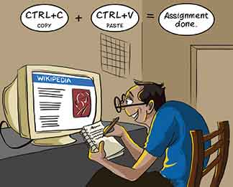
Grading
Using google and copying code is normal for programmers.
If you can complete your own assignment by copying off the internet, good for you. Your instructor is just incompetent.
This is different in other fields. We’re just talking Comp Sci!!
12
Welcome in

Slide 13


Grading
In short, you can:
• speak to the instructor or the TA
• use your computer to figure out the answer
You cannot:
• work with any other human beings, on any stage of your assignments, including discussing the discussions.
13
Welcome in

Slide 14
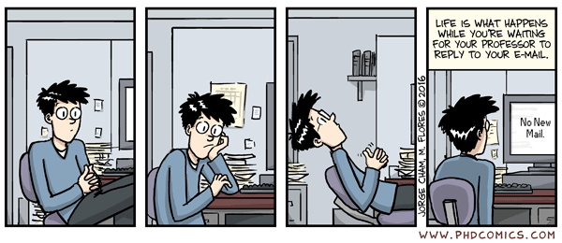
Emails
5 things you should do so your emails are answered fast ☺
14
Welcome in

Slide 15
Emails
Send administrative questions to the instructor, and other questions to the TA.
15
Welcome in

Slide 16


Emails
2. If something doesn’t happen like you expected, tell us what you expected
« Sir my program is not working can you help please »
« Sir I expected my program to process all lines in my file but it stopped after 100 lines »
16
Welcome in

Slide 17
Emails
3. For an assignment, do not ask to check whether what you did is right
Ultimately we tell you whether what you did is right. It’s called grading, and we do it once ☺
17
Welcome in

Slide 18
Emails
4. If you think you need a good amount of help then come to TA’s office hour, it’s going to be a lot more efficient than endless emails!
« I need help on the last lecture I don’t get the part about Awk so I’ll come to the office hour Friday »
« I am lost can I see you this afternoon »
18
Welcome in

Slide 19



Emails
5. We behave professionally in person. So be professional in emails as well.
Hi Philippe,
Dear Philippe,
Dear Dr. Giabbanelli,
Hey
nothing
Thank you,
Regards,
nothing
19
Welcome in

Slide 20


Emails
Good communication ☺
Bad communication ☺
20
Welcome in

Slide 21

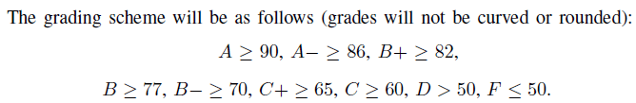
Other questions
1 page, both sides
Printed or written…
Last term, for that one class, we ended up with:
We always guarantee that F ≤ 50. Other categories vary based on overall class performance.
21
Welcome in

Slide 22
Other questions
« Do I need to buy books? »
We are not going to check what you read... You may choose to buy books for your own practice.
This book would be a good asset for you in the first two themes:
Practical Guide to Linux Commands, Editors, and Shell Programming. Mark Sobell, Prentice Hall, 3rd edition (2012). ISBN: 978-0133085044.
Is this book any good?
Ultimately, it depends on you. We learn things differently. You could borrow them first, and see if you really feel like reading them. If you buy them not to read them, it’s pointless.
22
Welcome in

Slide 23

23
Welcome in

Slide 24
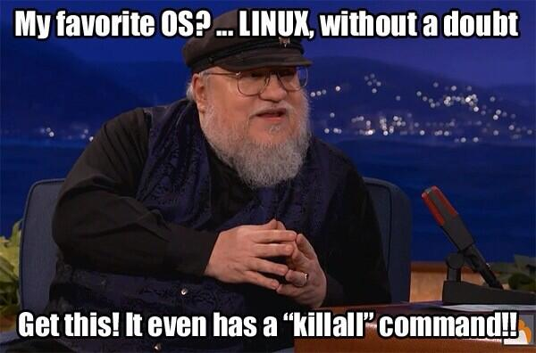
What is an operating system?
Take a few minutes to discuss it with the person next to you ☺
24
Welcome in

Slide 25
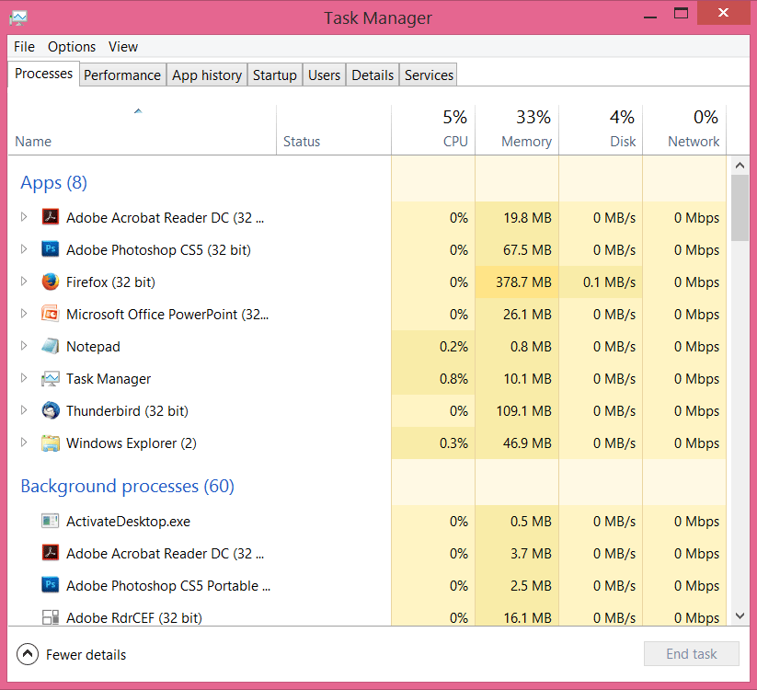
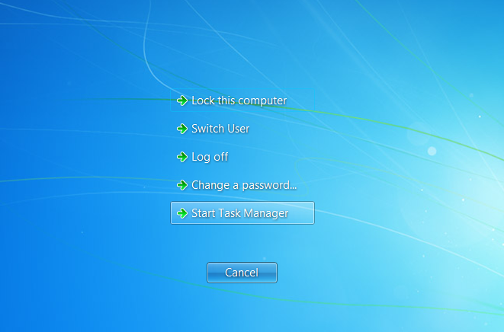

What is an operating system?
An operating system manages the resources.
25
Welcome in

Slide 26



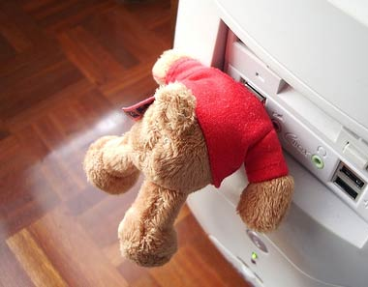
What is an operating system?
Whenever you plug in random stuff, you expect your computer to find out how to use it...
...that’s thanks to specific components of the operating system: drivers
If you want to know more about operating systems, just have a look at Operating Systems on Wikipedia!
26
Welcome in

Slide 27
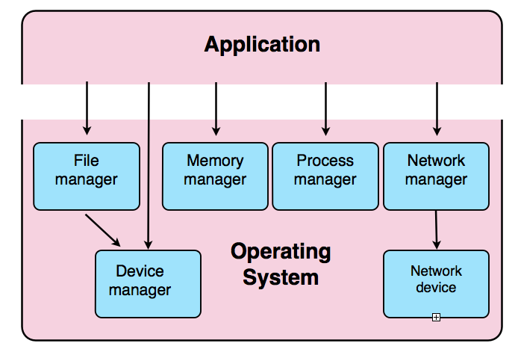



What is an operating system?
We will
We won’t
27
Welcome in

Slide 28

What is an operating system?
Can you give the name of 1 operating system?
kinda
We will
We won’t
28
Welcome in

Slide 29

What is an operating system?
Single-user, single-process operating systems:
allow only one user at a time on the computer system
user can execute/run only one process at a time
Examples: DOS, Windows 3.1
Single-user, multi-process operating systems:
allow a single user to use the computer system
user can run multiple processes at the same time
Example: OS/2
29
Welcome in

Slide 30
What is an operating system?
Current operating systems are typically multi-user, multi-process.
- allow multiple users to use the computer system simultaneously
- Each user can run multiple processes at the same time
Examples: UNIX, Windows NT (2000, XP, Vista)
That’s what this course is about!
30
Welcome in

Slide 31
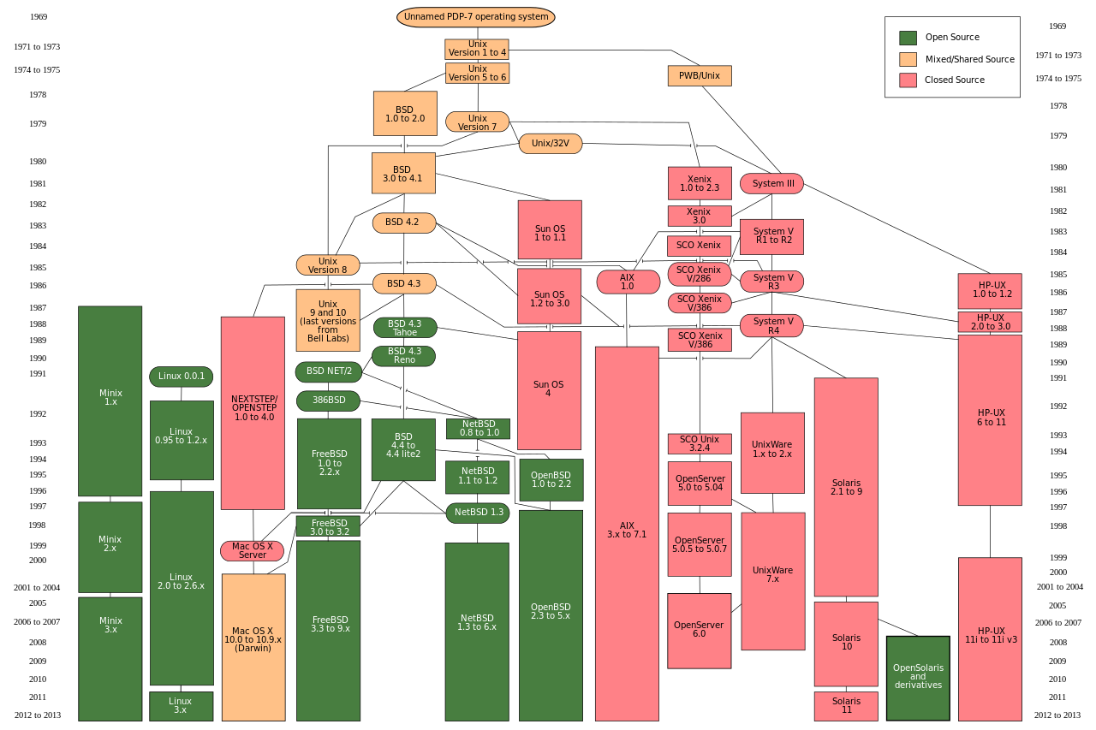
There are many UNIX-based systems. The one we’ll use is Linux.
31
Welcome in

Slide 32

What’s the purpose of this course?
OS can do lots of things, and there are many of them.
32
Welcome in

Slide 33

What’s the purpose of this course?
You’ll essentially learn these using that.
33
Welcome in

Slide 34
What’s the purpose of this course?
You’ll essentially learn these using that.
You need Linux for the course, and you’ll need to practice on it
You can log in remotely to hopper.cs.niu.edu, or go to the labs in the basement and use a virtual machine (http://courses.cs.niu.edu/unix/)...
...but, really, you should get your own Linux.
Let’s look at how you can get a working Linux...
34
Welcome in

Slide 35
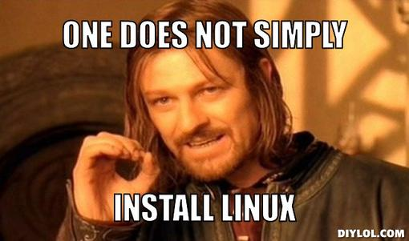
Installing Linux
The idea: go pick an install a Linux
35
Welcome in

Slide 36
Installing Linux
There are many Linux distributions. You’ll need to pick one.
They include a core based on Linux, ways for you to install what you need, and other software that may be free or not.
If you want to know more about Linux distributions have a look at Linux Distribution on Wikipedia!
36
Welcome in

Slide 37
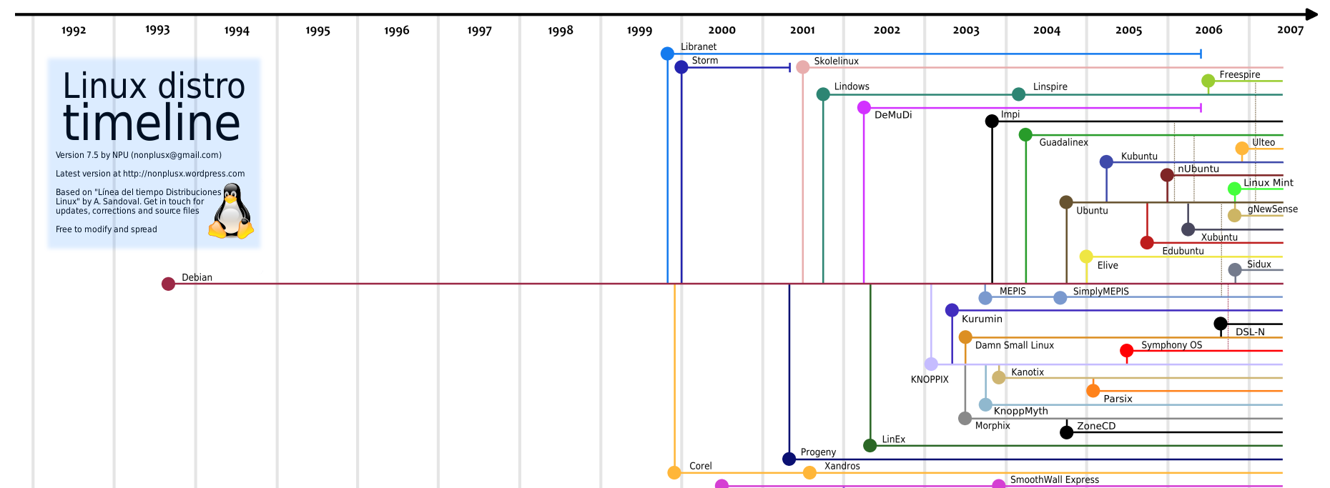





Ubuntu is nice for those new to Linux.
We use Debian. Totally free, and most popular for personal use. Seen as ‘rock solid’: not pretty, but reliable!
Easy to install stuff, professional, but not particularly nice to newbies.
37
Welcome in

Slide 38
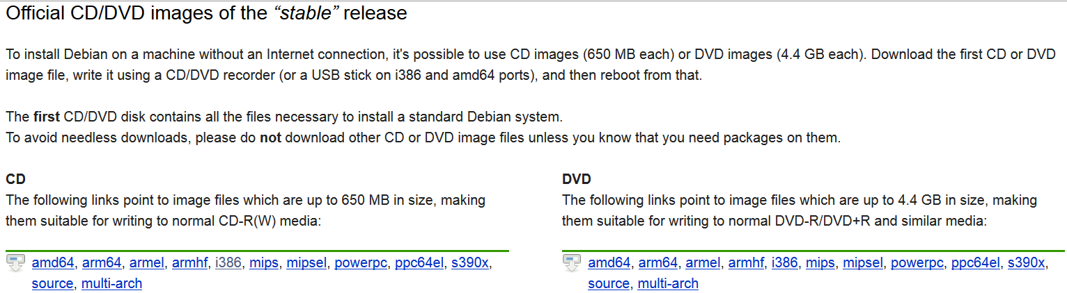
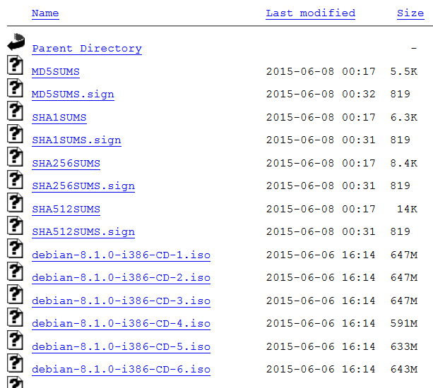
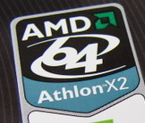

Installing Linux
To download a Debian, go to https://www.debian.org/CD/http-ftp/#stable
Or 8Gb USB stick
38
Welcome in

Slide 39
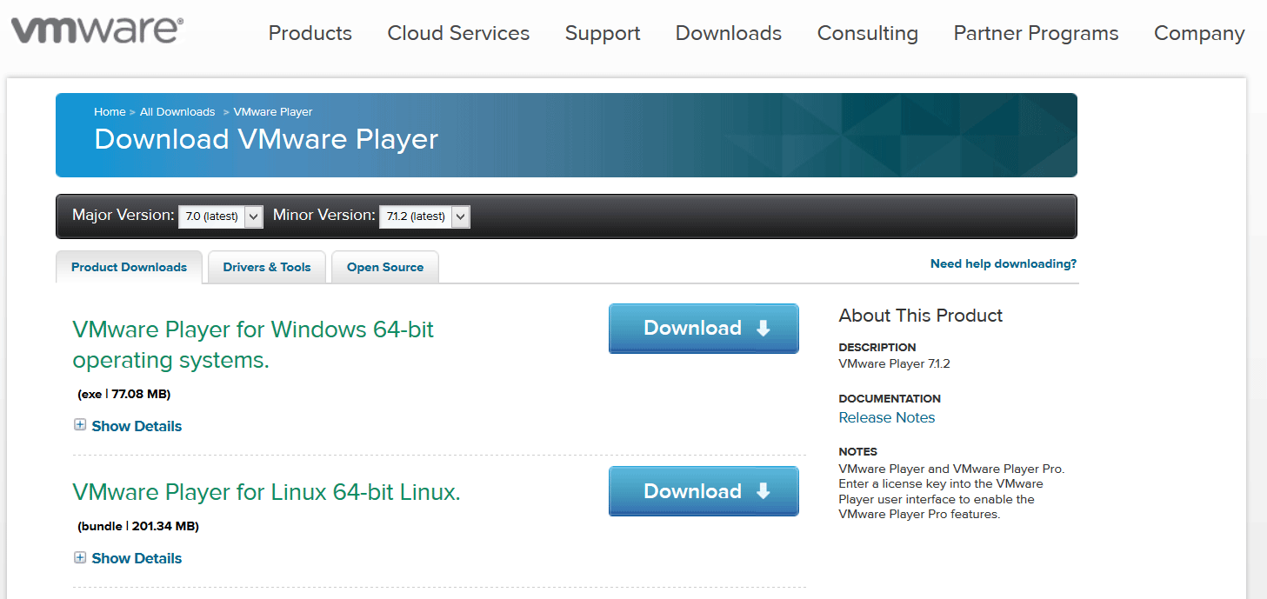
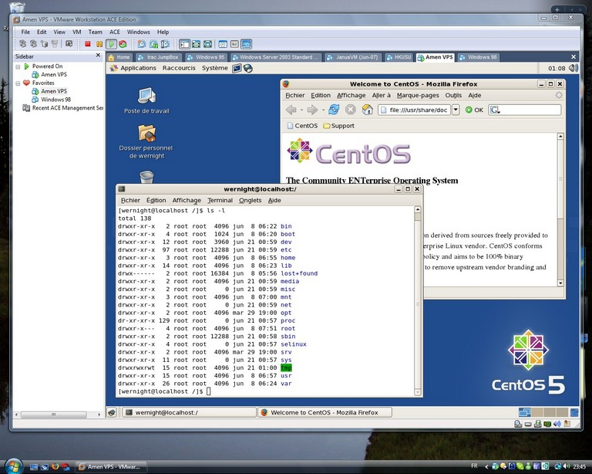
Installing Linux
You can use a virtual machine.
That way you don’t need to choose between Linux/Windows. You just run both.
Note that your computer should have enough memory!
Download VMWare Player to do that.
39
Welcome in

Slide 40
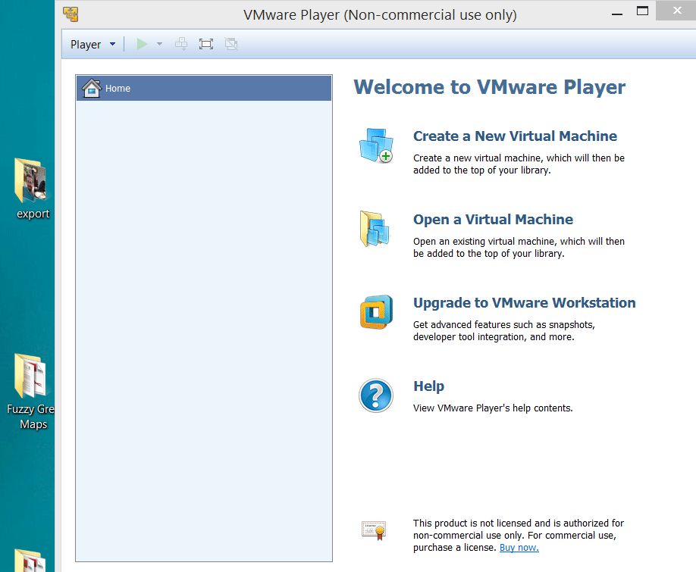
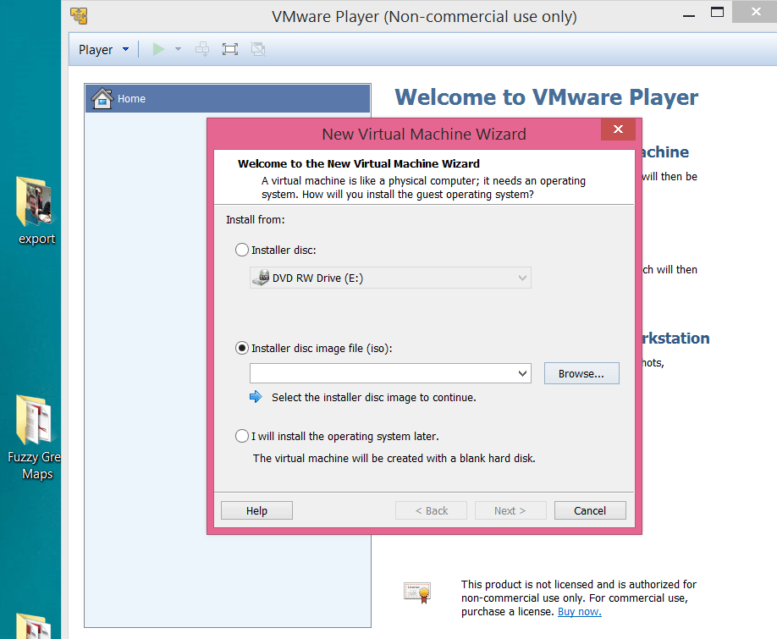
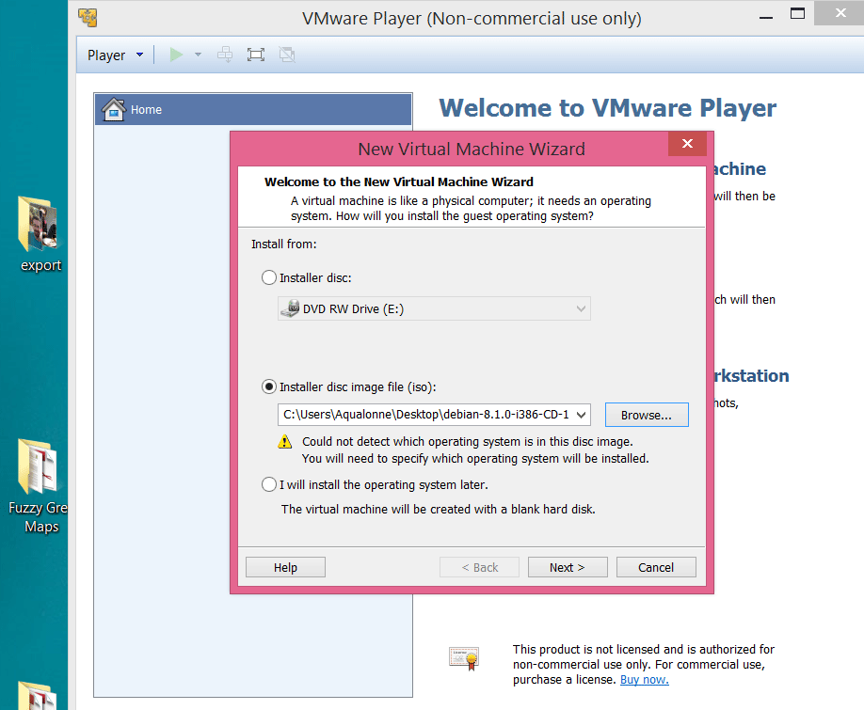
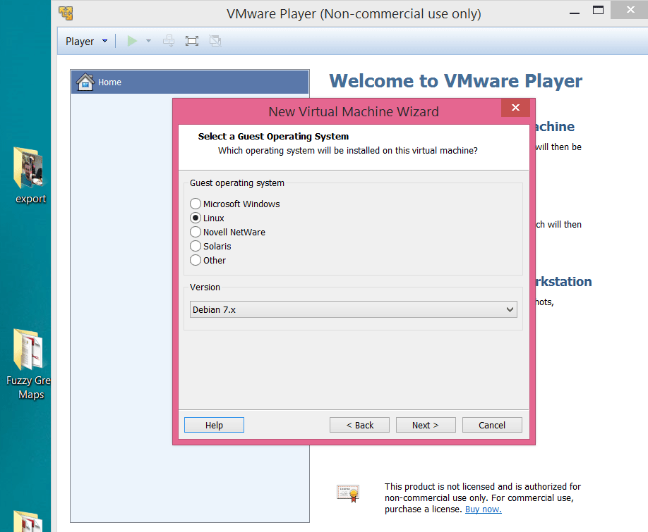
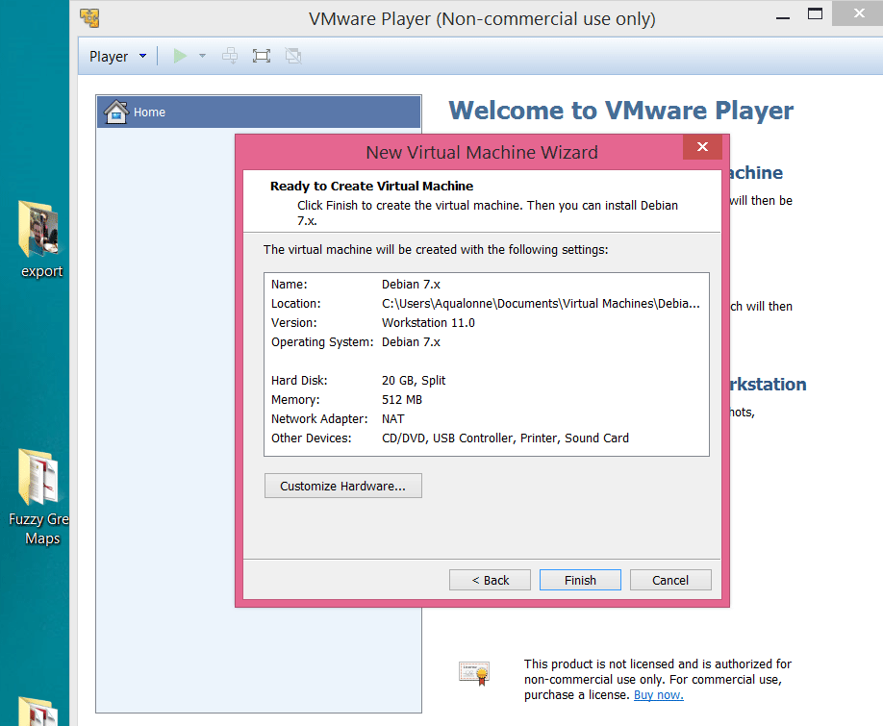
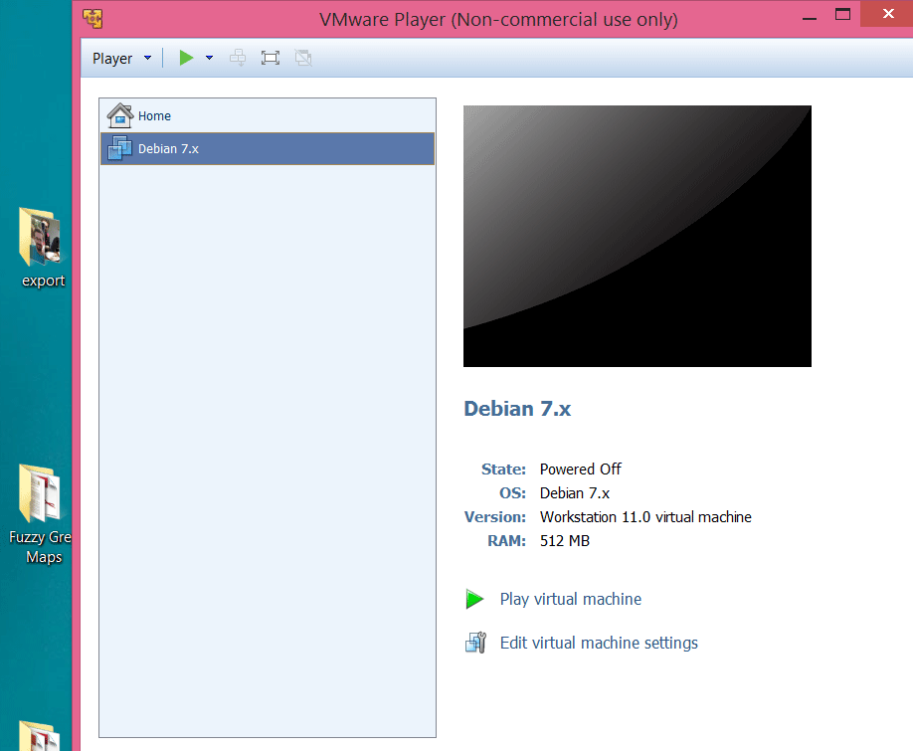
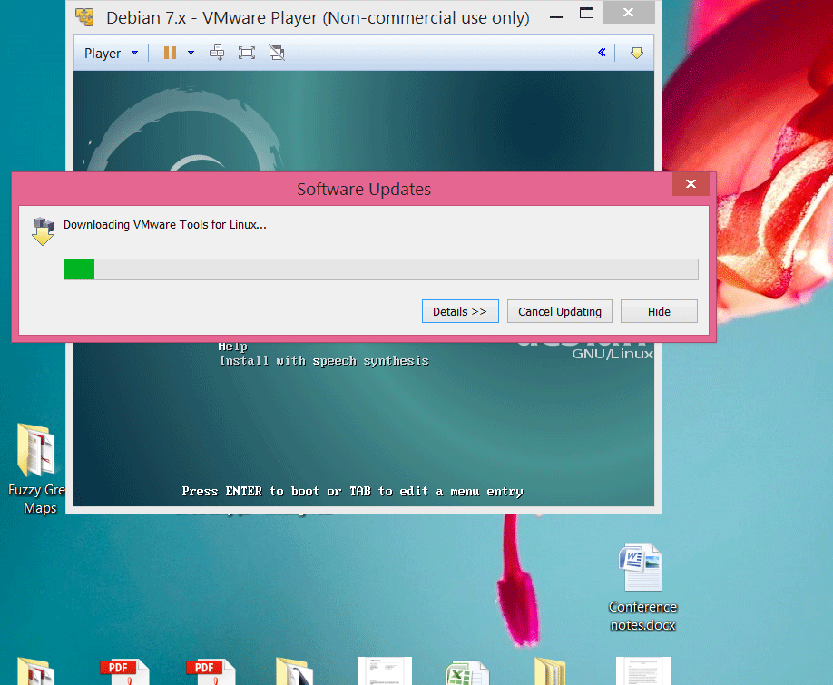
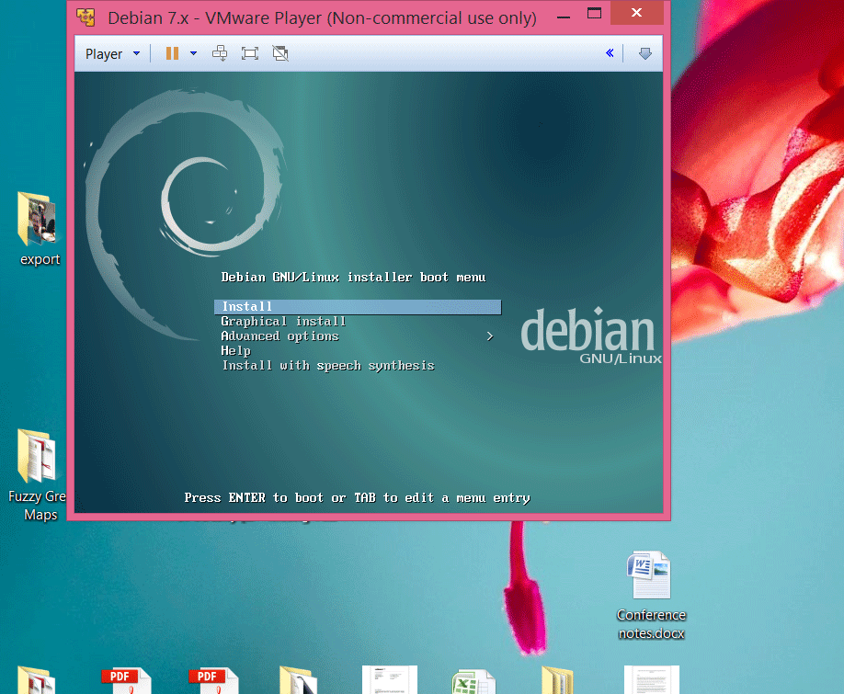
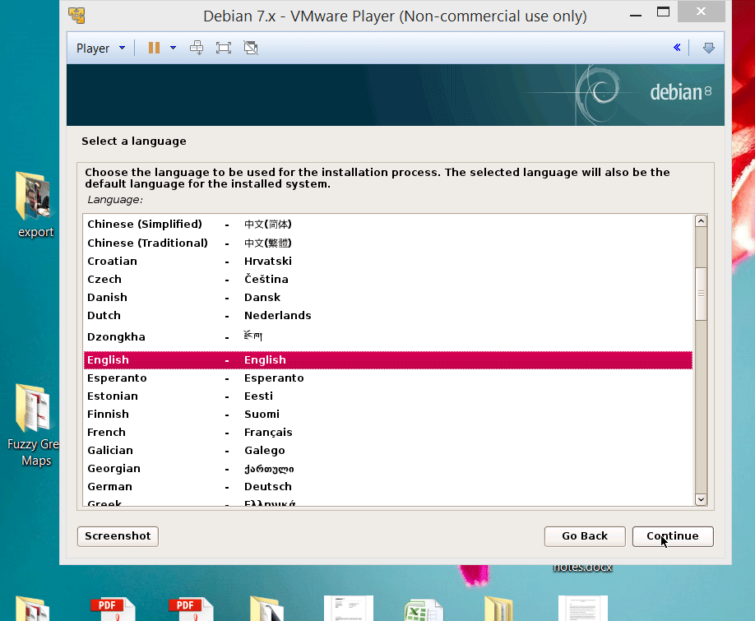
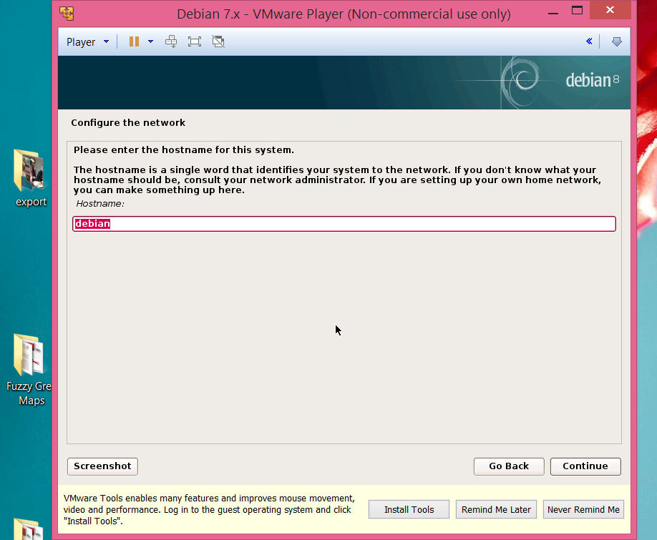
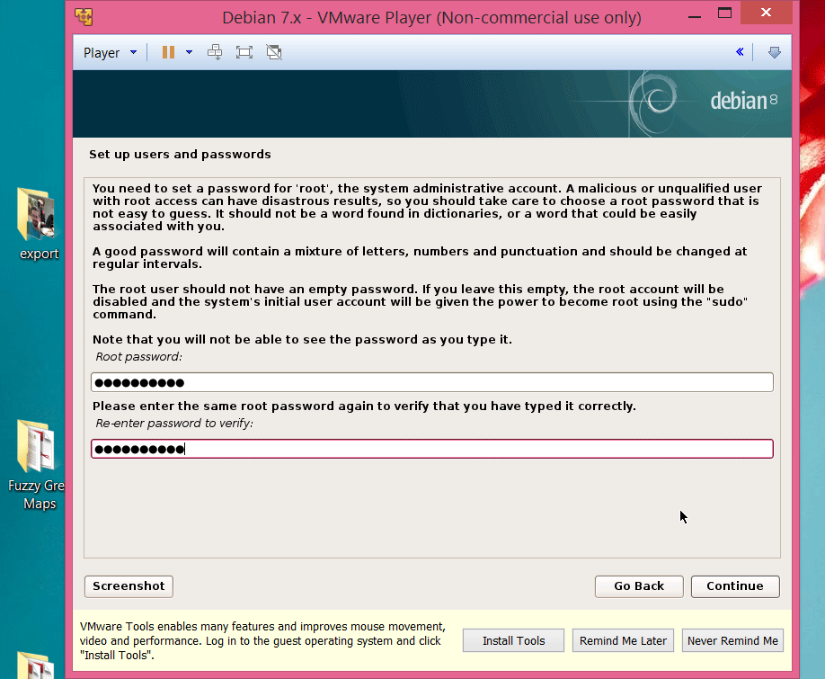
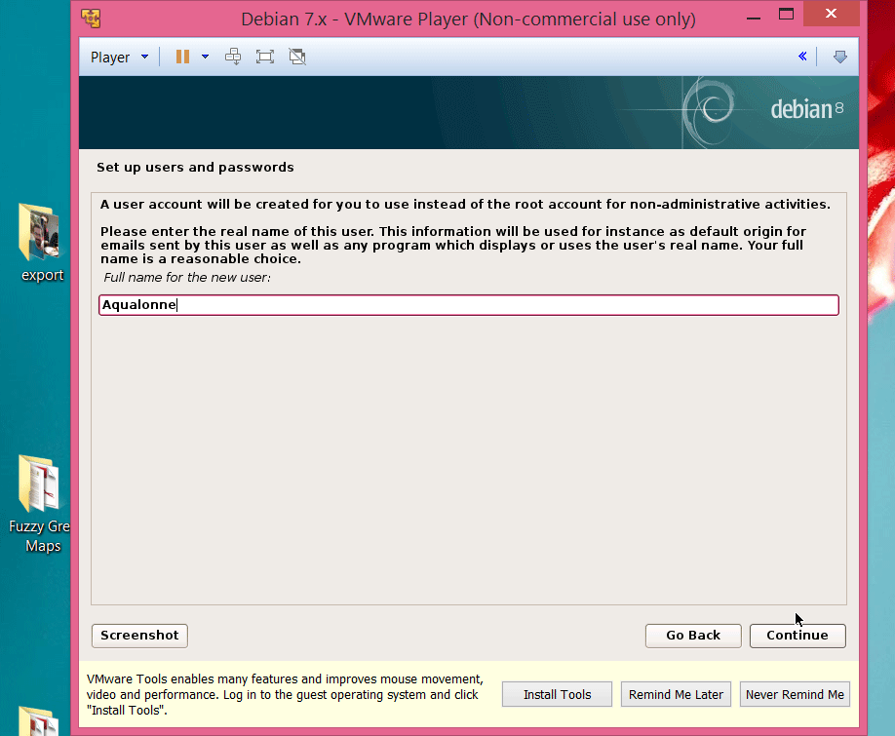
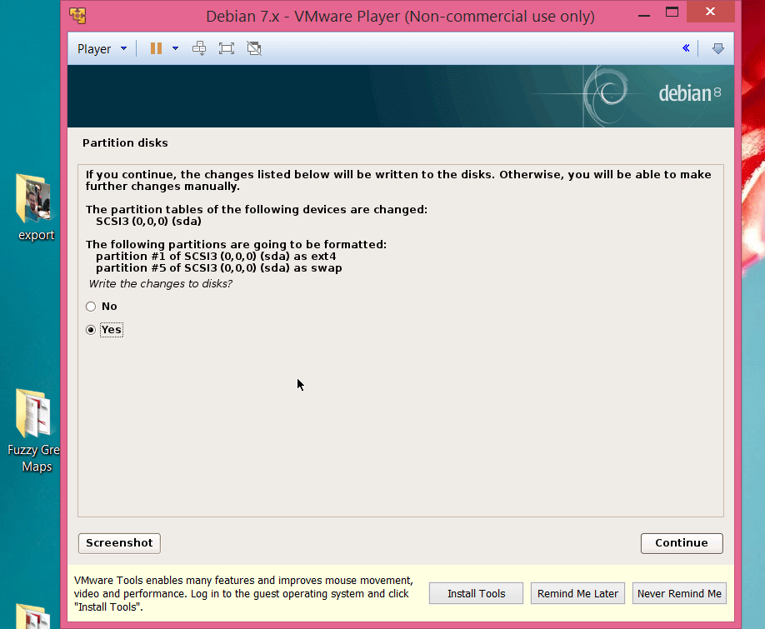
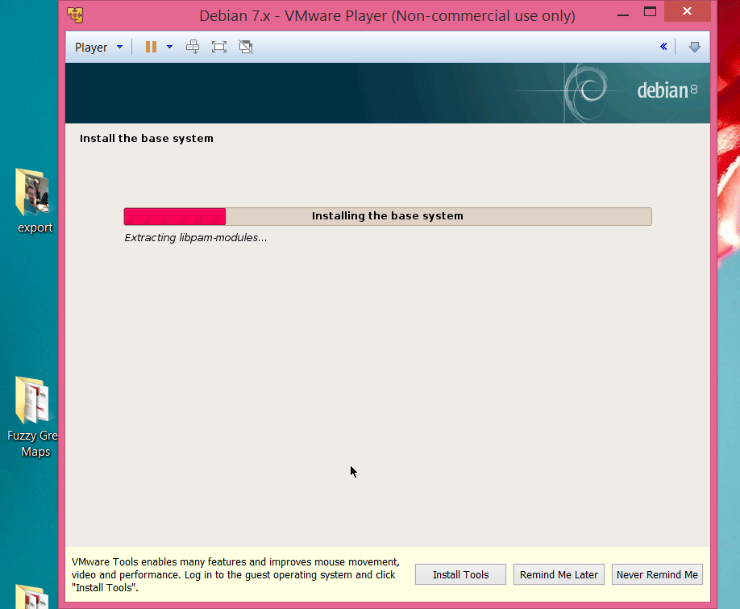
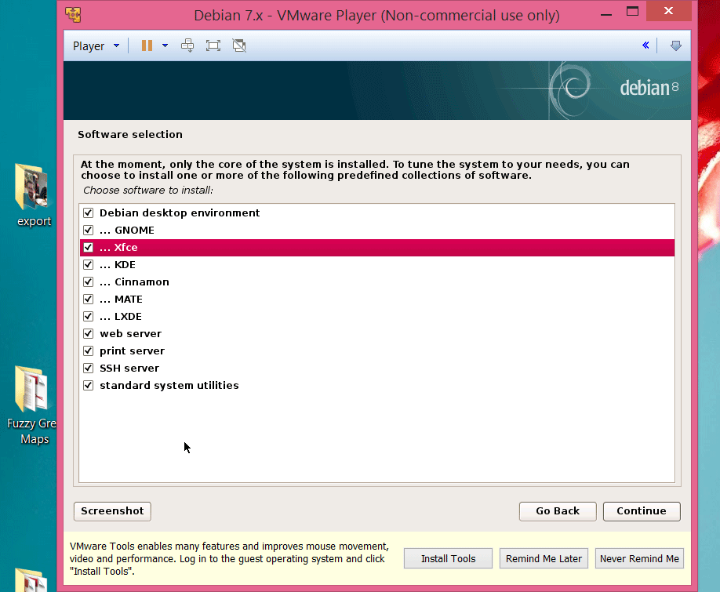

Installing Linux
When you reach that stage it may take 2 hours or so. So do it overnight, while you cook dinner or watch a movie...
40
Welcome in

Slide 41
Installing Linux
My advice: get and install Linux on your machines. You should have done it once in your life.
On Thursday you will have the option between:
Installing a Debian as you’ve just seen (download image, create/configure virtual machine)
Installing a Linux Mint for lazy people (download... and open pre-installed image)
Look at the install instructions and DOWNLOAD A LINUX ASAP! Or painfully watch 30+ people downloading it together at snail speed for 1 hour
41
Welcome in

Slide 42

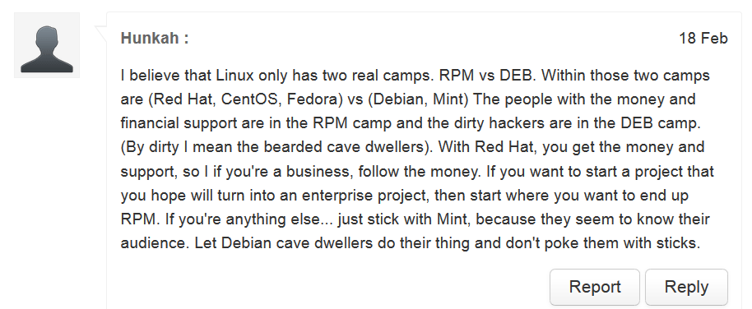
Once you’re in the real-world, it’s up to you what Penguin you prefer. There are pros & cons, and a lot of ‘attitude’ too ☺
42
Welcome in

Slide 43
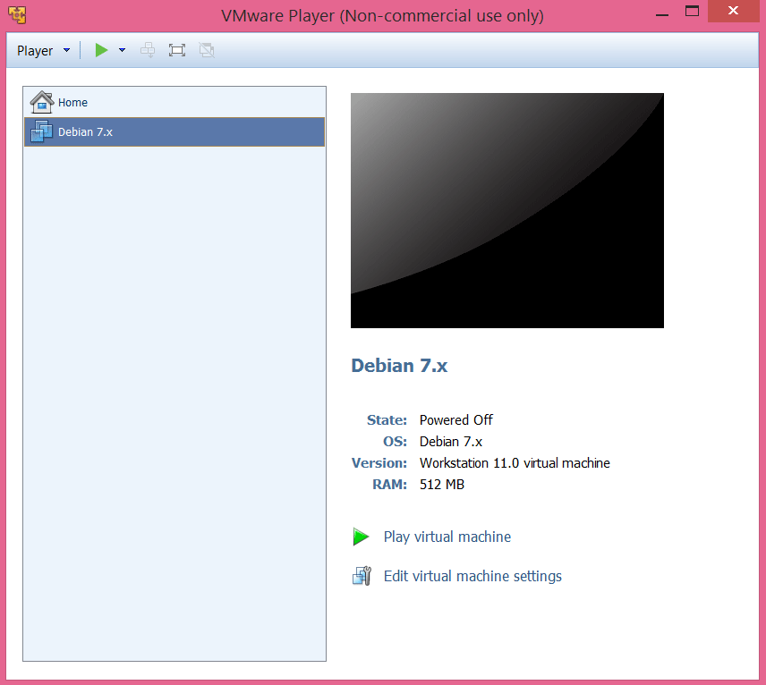
Running Linux
43
Welcome in

Slide 44

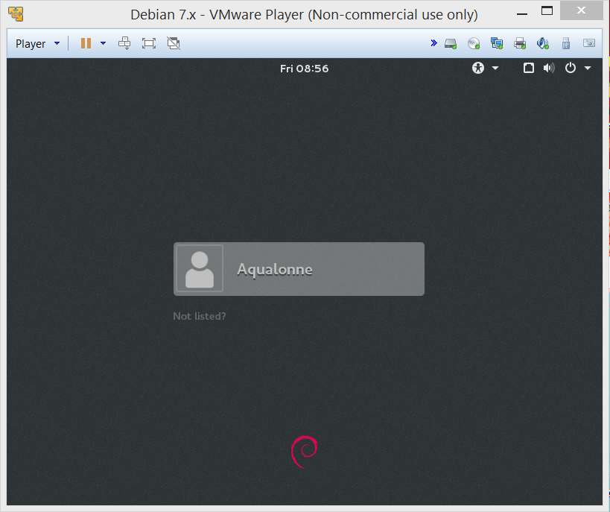
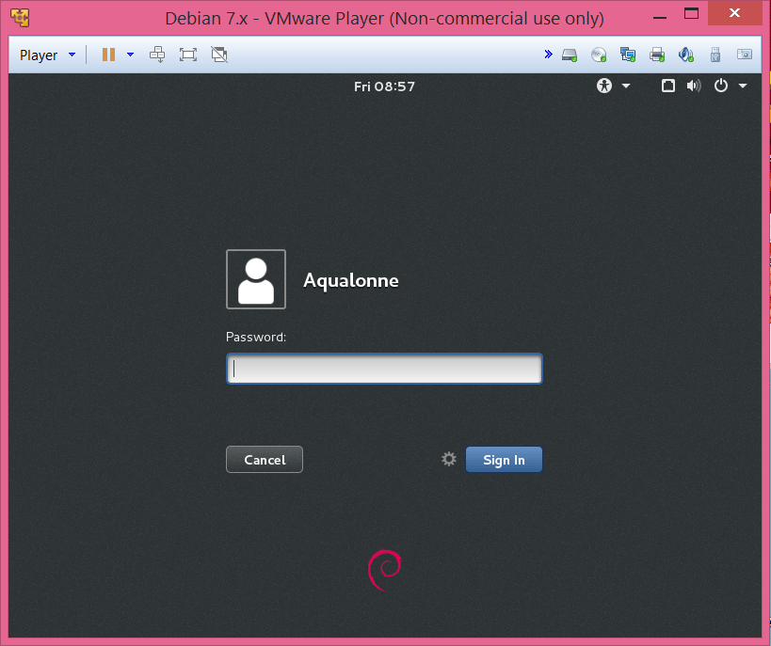
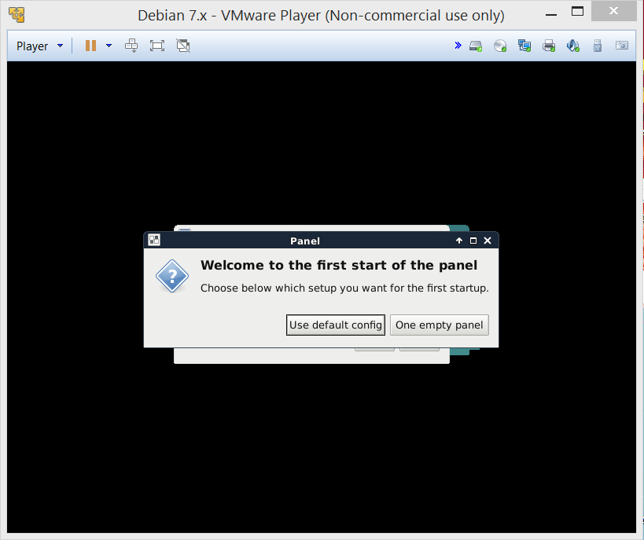
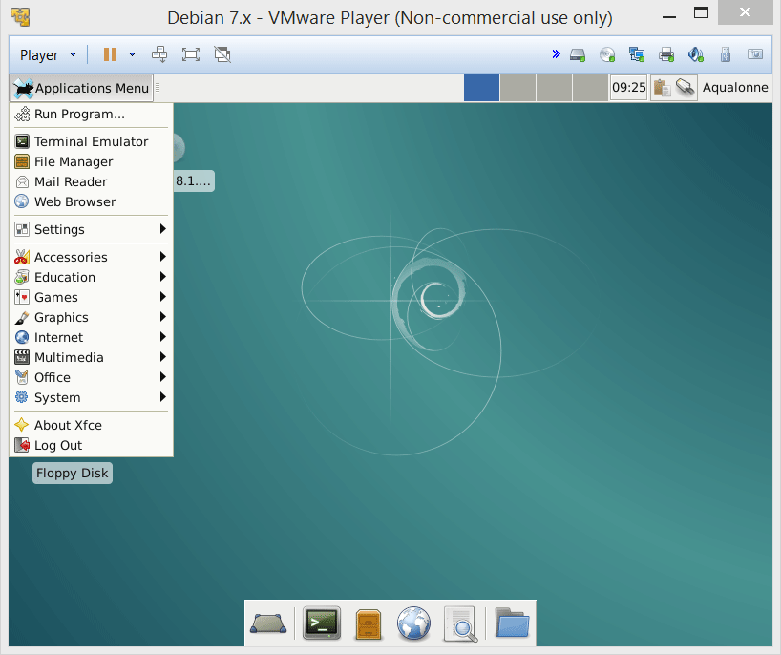
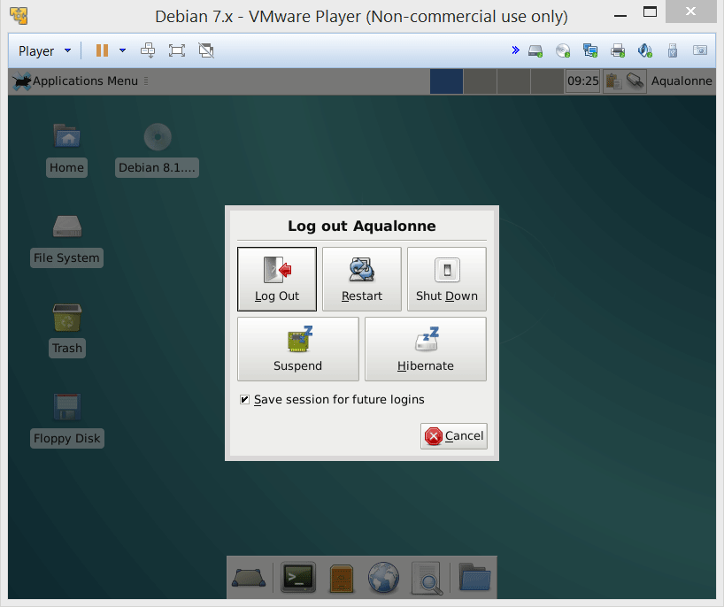
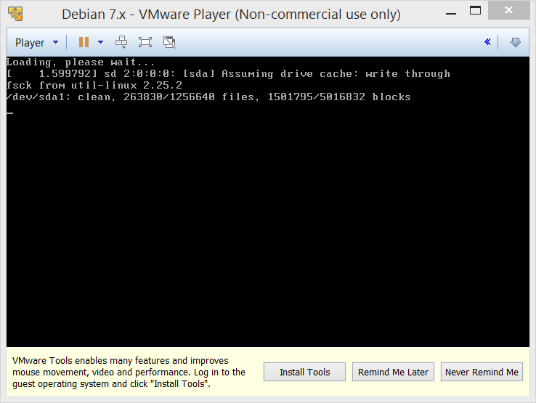
Running Linux
When you are done, shutdown
Do NOT use the X to close the window, it’s like stopping a computer by unplugging!
44
Welcome in

Slide 45
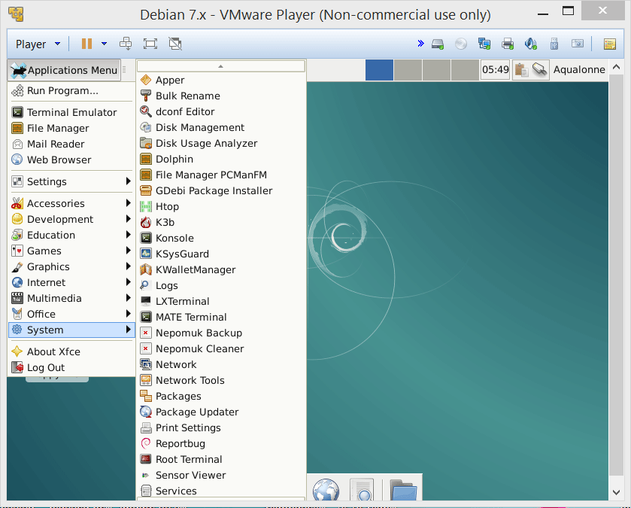
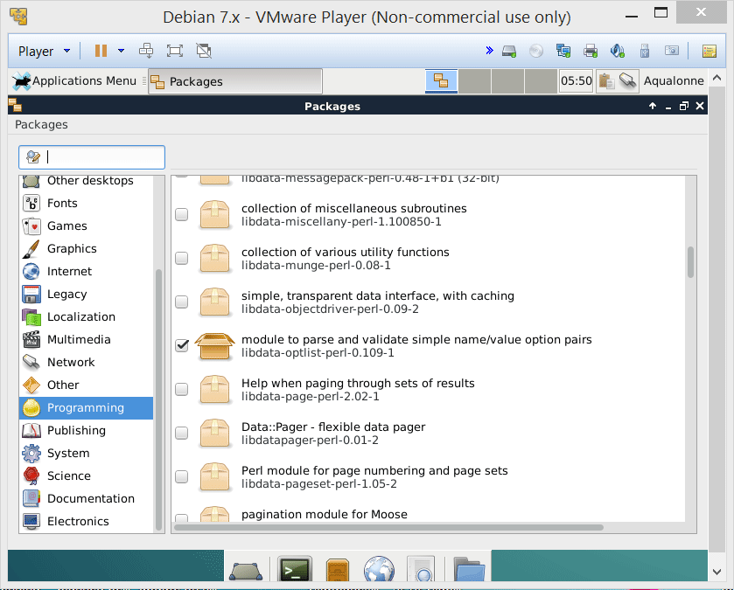
Running Linux
Then you can type the name of the program you want (if known)
If you need to install anything just by clicking
Or browse per category
45
Welcome in

Slide 46

46
Welcome in

Slide 47

Practice questions & activities
We recommend that you do these, but that’s for your own good, not graded.
What’s an operating system for?
In the grid below, tell us whether it’s a combination we currently use, stopped using, or never used.
Cite 3 Linux distributions.
Have your own Linux. On Thursday we will show you one way to do it.
 | Single process | Multiple processes
Single user
Multiple users
47
Welcome in

Slide 48

To go further…
48
Welcome in

Slide 49
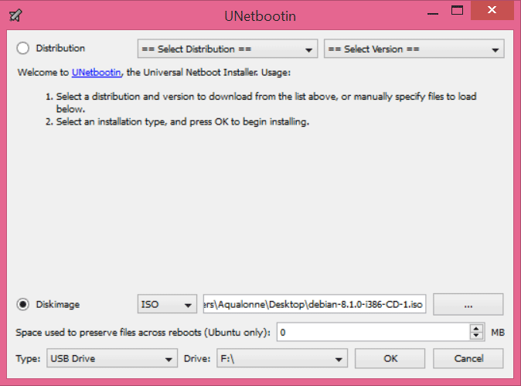
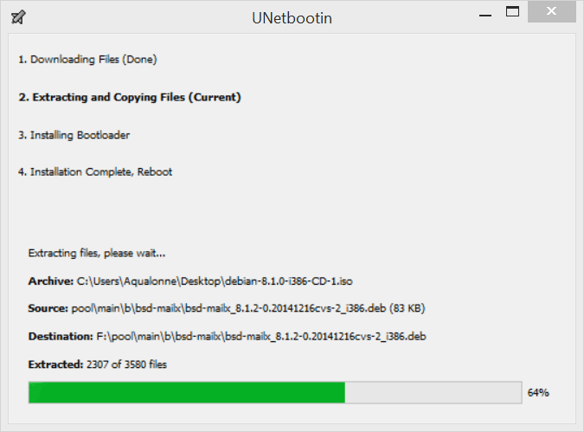
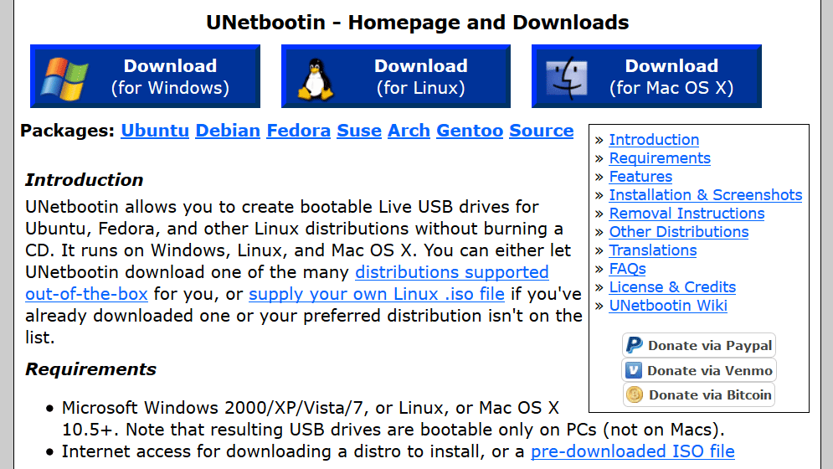
Other ways of installing linux (1): booting on a USB
You can run Linux from a USB Stick. That way, when your computer starts, you can start either Linux or Windows. To do that...
(i) Download UNetbootin
(ii) Plug in the USB
(iii) Start UNetbootin
(iv) Select the iso file and your USB stick
(v) Wait a long time
49
Welcome in

Slide 50
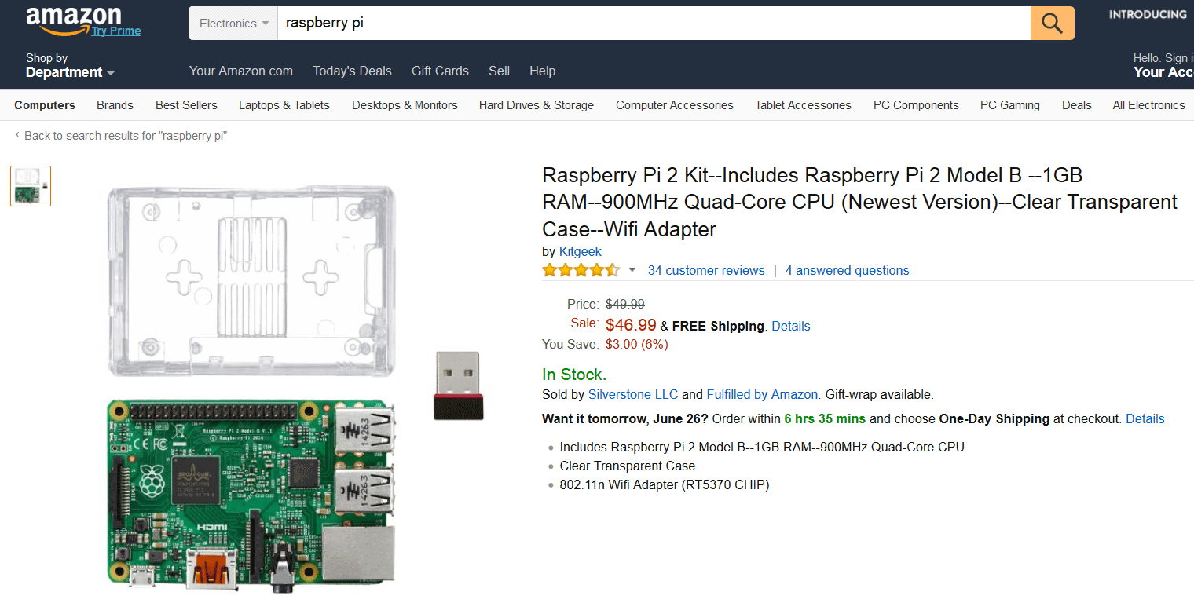
Other ways of installing linux (2): get a linux system
Buy a computer that already has Linux such as Raspberry Pi ($30-70 without screen)
50
Welcome in

Slide 51
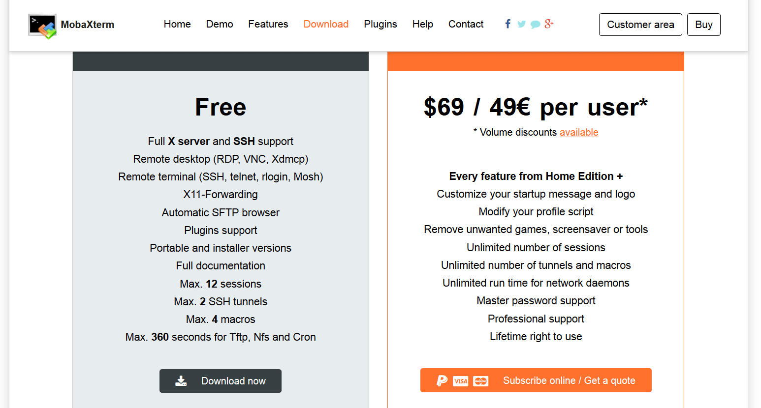

Other ways of installing linux (3): don’t install it…
There is a variety of Linux emulators that run in Windows and allow to do very basic stuff.
51
Welcome in

